Slide 1

㈜에이씨케이

Slide 2

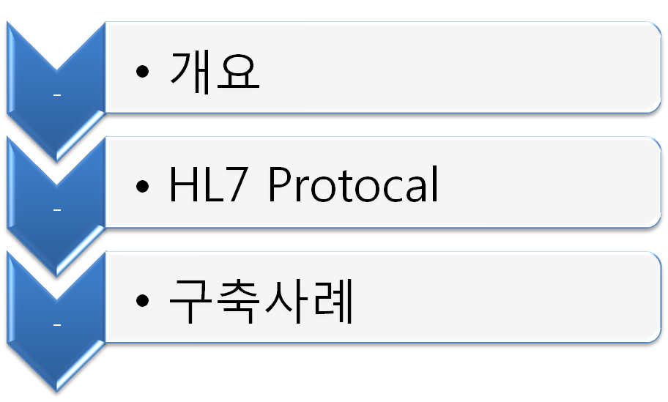

Slide 3


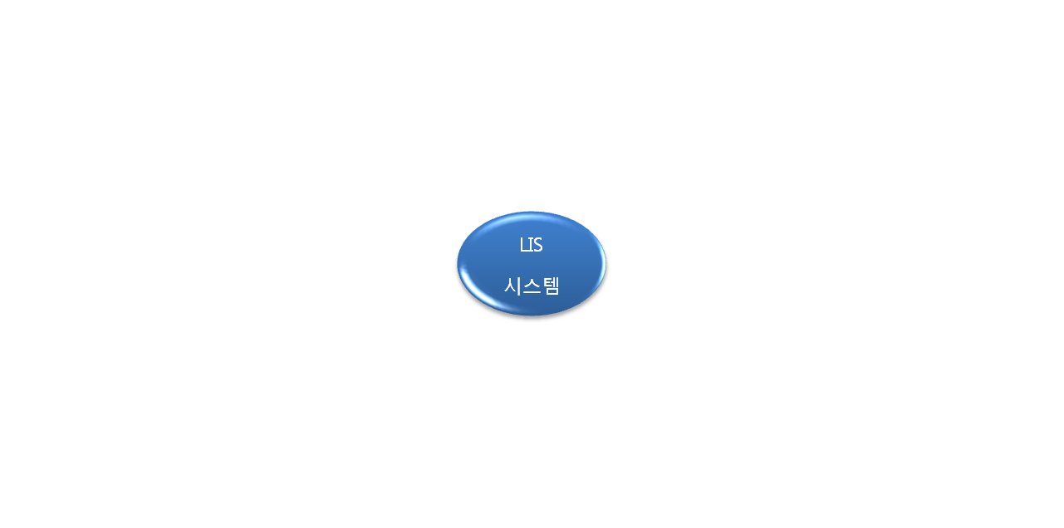
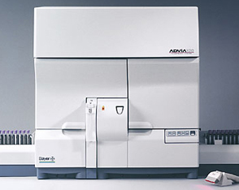


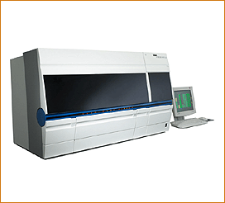


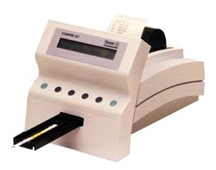
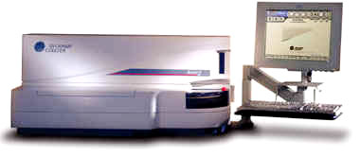
HL7
HL7
HL7
HL7

Slide 4
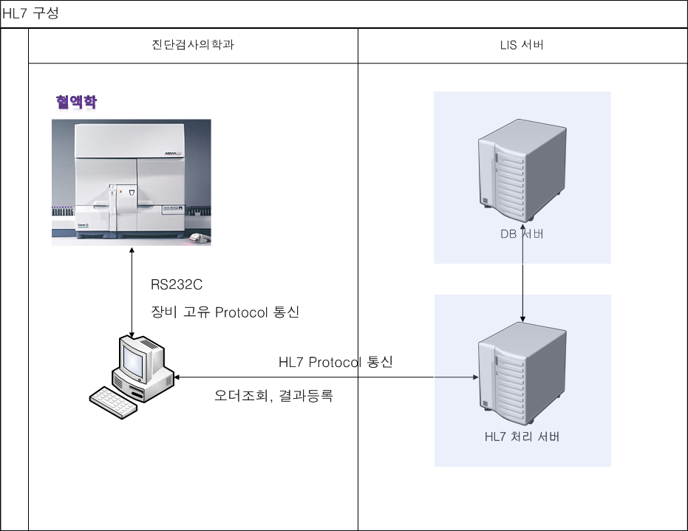

Slide 5

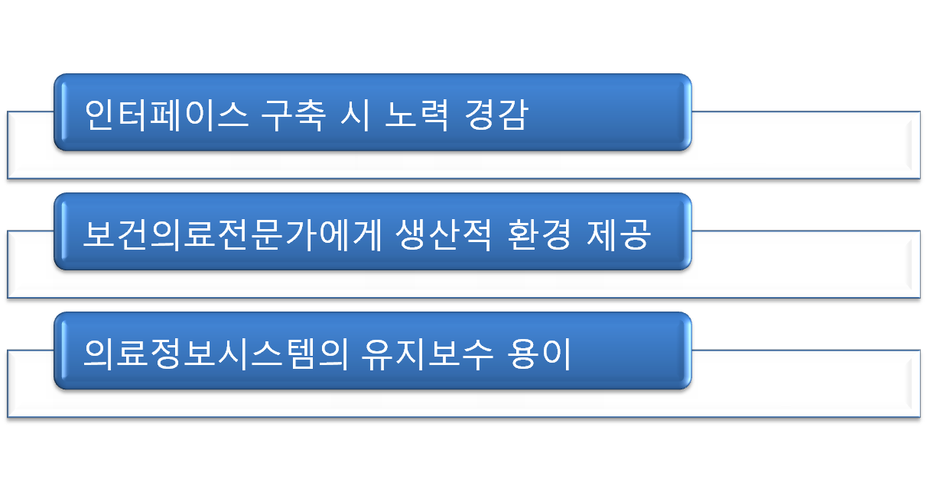
참고자료 : 진료정보전송표준개발 보고서

Slide 6

Health Level Seven Standard(HL7)는 시스템간의 데이터를 교환하기 위해 사용된다.
<SB> <HL7 message> <EB> <CR>
where:
<SB> = Start Block character (0x0B)
<EB> = End Block character (0x1C)
<CR> = Carriage Return Character (0x0D)

Slide 7
결과 Message 구성
􀀀 MSH—Message header segment
􀀀 PID—Patient identification segment
􀀀 PV1—Patient visit segment
􀀀 OBR—Observation request segment
􀀀 OBX—Observation result segment(s)
오더조회 Message 구성
􀀀 MSH—Message header segment
􀀀 PID—Patient identification segment
􀀀 PV1—Patient visit segment
􀀀 OBR—Observation request segment

Slide 8

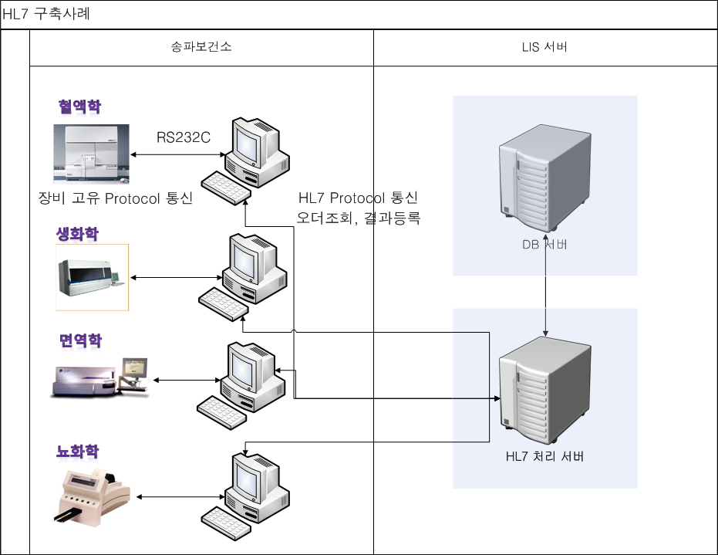

Slide 9
개발대상 검사기기 목록
생화학
1) Cobas Integra 400
2) Olympus AU 400
3) Dimension AR
면역학
1) Advia Centaur
2) ACCESS 2
3) VIDAS
혈액학
1) Sysmex K-4500
2) Advia 120
뇨화학
1) UriSCAN Pro
2) Clinitek 500
전해질
1) NOVA 5

Slide 10


